Slide 1



Citi Bike Data Analysis
26464 Benineza Moise

Slide 2
Project Introduction
Objective:
Analyze bike-sharing data to uncover rider behaviors, optimize service delivery, and propose strategic recommendations.
Dataset:
Came from Citi Bike official site and it includes trip start/end times, locations, ride types, and user types (member/casual).
Goals:
Predict rider types
Segment trips into behavior clusters
Infer trip purposes
Build interactive dashboard for stakeholders
2

Slide 3
Methodology Overview
Tools Used:
Python (Pandas, Sklearn, Seaborn, Matplotlib)
Power BI
DAX for custom metrics
KMeans clustering
Random Forest Classifier
Key Steps:
Data Cleaning & Transformation
Exploratory Data Analysis (EDA)
Classification & Clustering
Purpose Inference (Innovative)
Dashboard Design
3

Slide 4
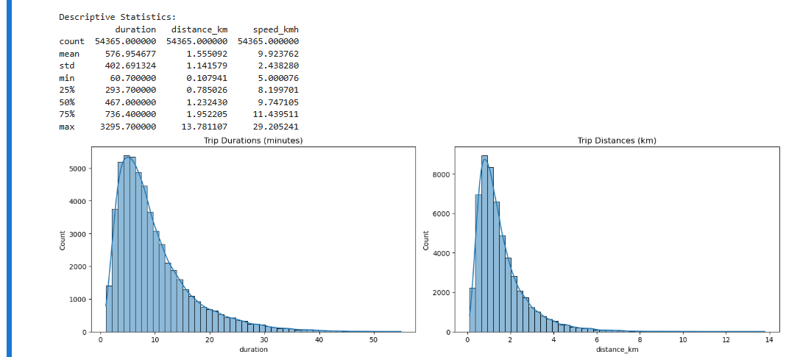
Python (Pandas, Sklearn, Seaborn, Matplotlib)
Descriptive statistics give us a summary of our dataset. They help us understand the central tendencies, spread, and overall shape of our data.

Slide 5
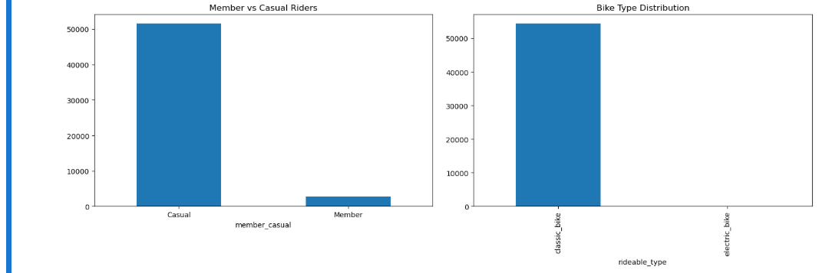
Python (Pandas, Sklearn, Seaborn, Matplotlib)
Visualizing Distributions help us see how your data is spread across different values.

Slide 6
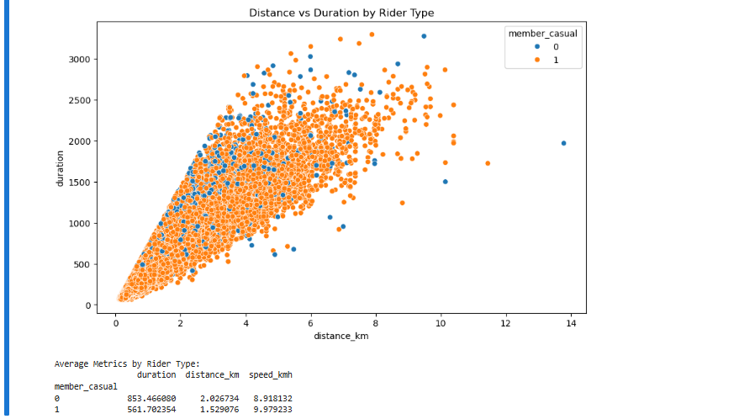
Python (Pandas, Sklearn, Seaborn, Matplotlib)
Visualizing Distributions help us see how your data is spread across different values.

Slide 7
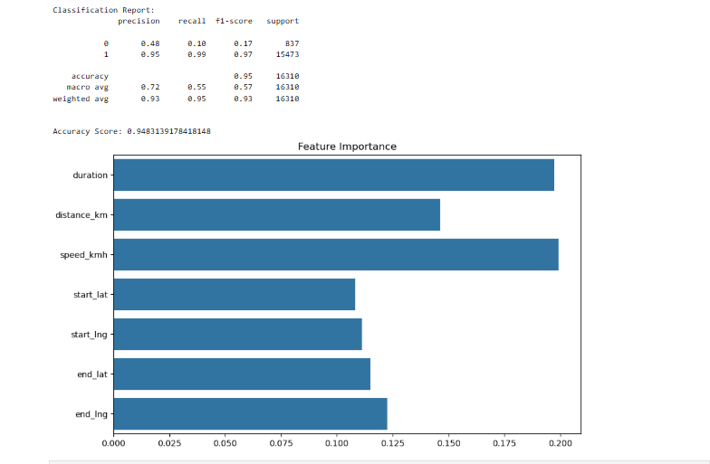
Applying a Machine Learning or Clustering Model
I chose classification as the suitable model. Why? Because the goal was to predict or distinguish between predefined categories

Slide 8
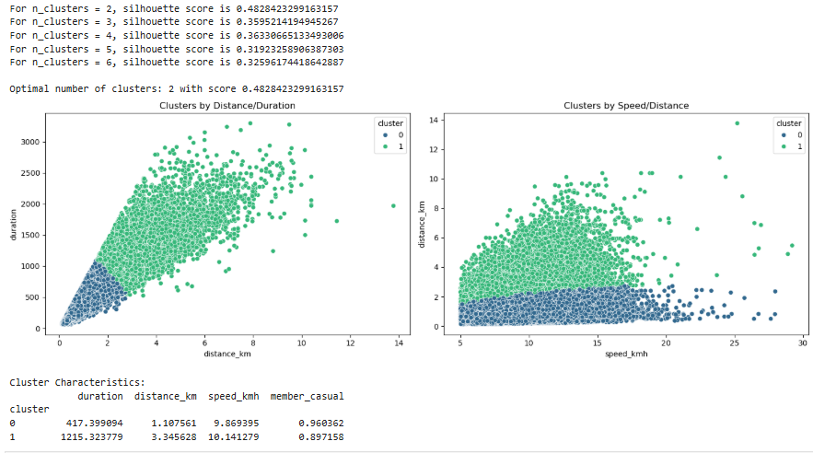
Evaluating the Model
I chose silhouette score as the evaluation metrics because we did clustering as well

Slide 9
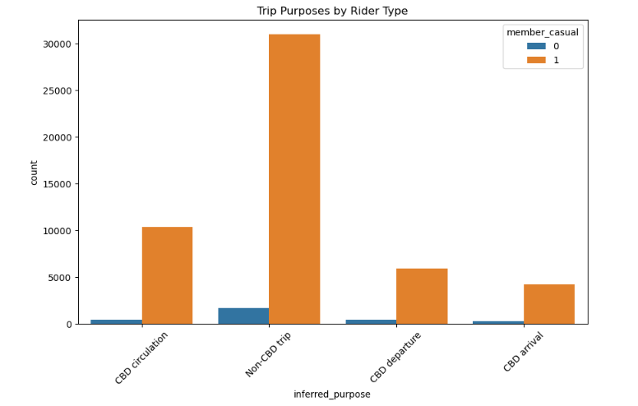
Incorporate Innovation

Slide 10
Creating the final clean dataset
Creating a clean dataset is one of the most critical steps in any data analytics or machine learning project. To Remove Raw data that’s often messy with missing values, duplicates, typos, and outliers.
cleaned_df.to_csv('bike_cleaned.csv', index=False)

Slide 11

Power BI Dashboard
Using Power BI, design a dashboard to present our data insights

Slide 12
Power BI Dashboard
Problem & Insights
Analyzing ride durations, distances, stations, speed and purpose of ride covered by Citi Bikes.
Purpose: Analyzing bikes ridden in the city what purpose they were ridden for, where they were ridden at and if the rides were by members or casuals
12

Slide 13
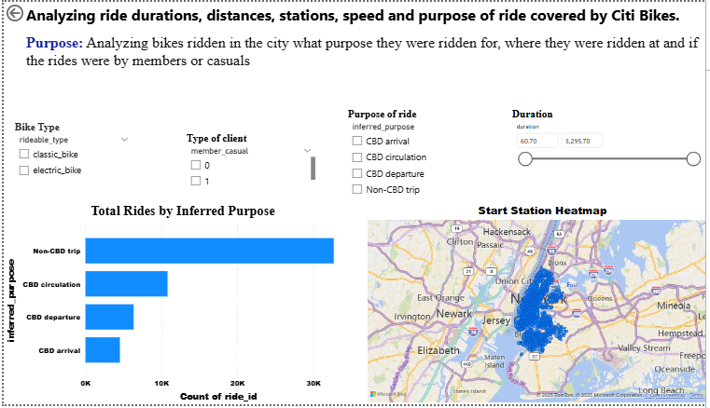
Incorporate Interactivity with the Appropriate Visuals
The Power BI dashboard is the visual storytelling layer of your data project it helps us see and understand insights that are difficult to detect from raw numbers or code alone.

Slide 14
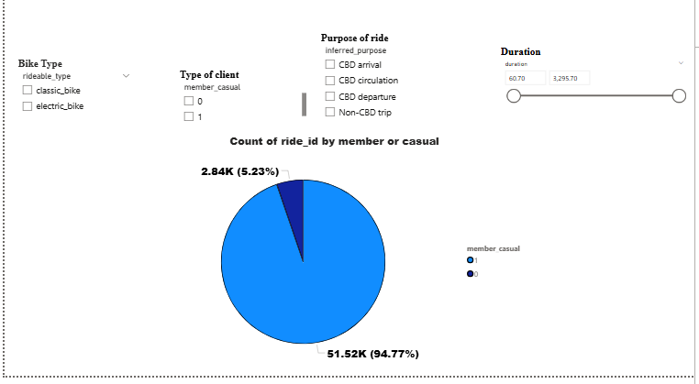
Incorporate Interactivity with the Appropriate Visuals
The Power BI dashboard is the visual storytelling layer of your data project it helps us see and understand insights that are difficult to detect from raw numbers or code alone.

Slide 15
Here’s what it specifically the Power Bi helps us with:
1. Visualizing Key Insights
It transforms cleaned data into interactive visuals like bar charts, line graphs, maps, and cards.
2. Communicating Complex Data Simply
Dashboards summarize key metrics (e.g., average speed, total trips, monthly usage) in a clear way.
Makes it easier for stakeholders to make informed decisions without needing to understand the code or data structure.
3. Interactivity and Exploration
Users can filter data (e.g., by date, rider type) using slicers and dropdowns.
4. Real-Time Monitoring and Automation
Dashboards can refresh automatically when connected to live data sources.
5. Professional Presentation
Makes your project look polished and easy to navigate. Useful for final reports, pitches, or stakeholder presentations.

Slide 16
END

